Slide 1

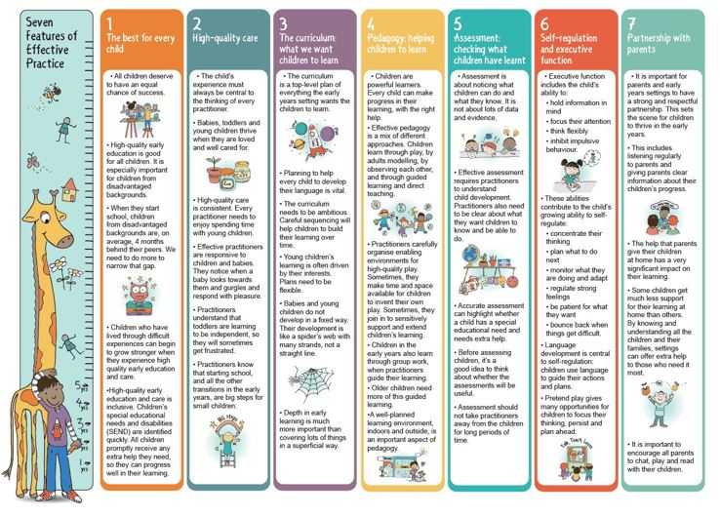
St Andrew’s Foundation Class Curriculum
24-25
Our Intent
In EYFS at St Andrew’s School, the curriculum is designed to recognise children’s prior learning from previous settings and their experiences at home, provide first hand learning experiences, whilst allowing the children to build resilience, ambition and integrity. Every child is recognised as a unique individual and we celebrate and welcome differences within our school community. The ability to learn is underpinned by the teaching of basic skills, knowledge, concepts and values. We provide enhancement opportunities to engage learning and believe that our first experiences of school should be happy and positive, enabling us to develop a lifelong love of learning.
We intend: To work in partnership with parents and carers to encourage independent, happy learners who thrive in school and reach their full potential from their various starting points. To understand and follow children’s interests and provide opportunities throughout our EYFS curriculum to support learning, consolidate and deepen knowledge and ensure children meet their next steps. To create an indoor and outdoor environment which supports learning. To prepare children to reach the Early Learning goals at the end of the Foundation Stage and ensure children make at least good progress from their starting points. To support transition into KS1.
Image – Julian Grenier 2021

Slide 2
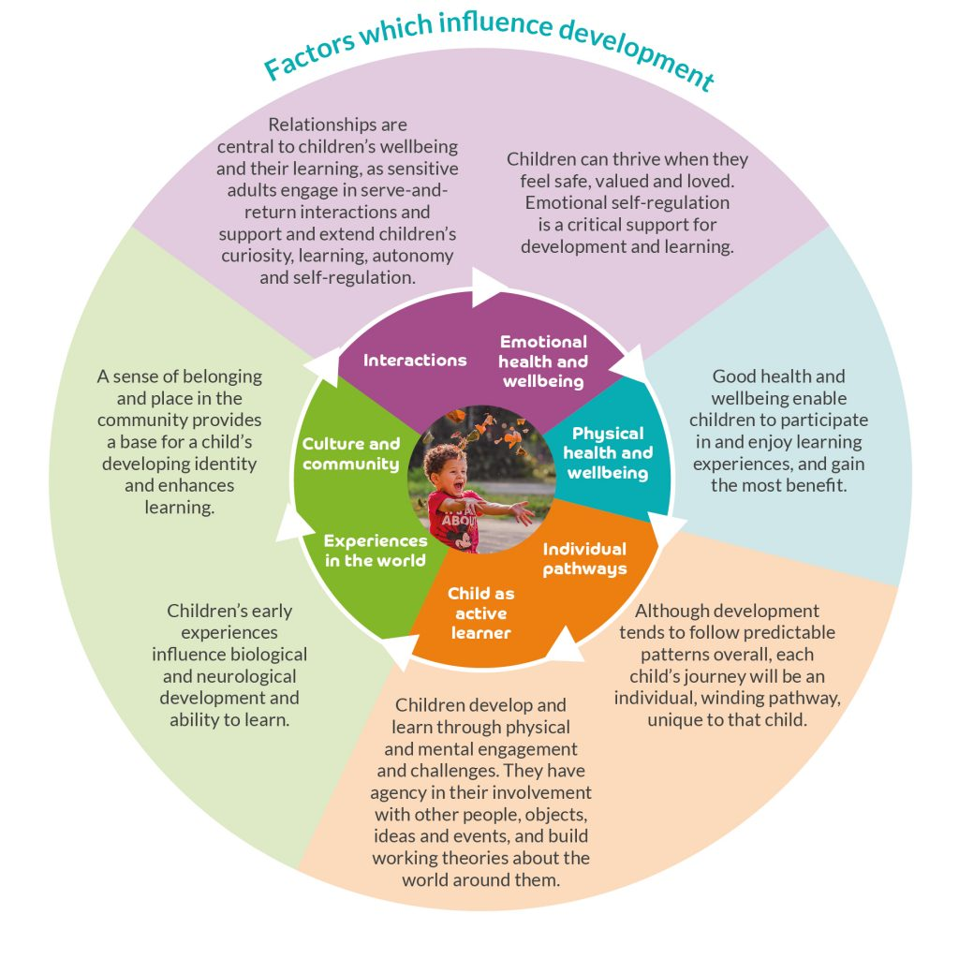
Implementation
We have a curriculum that is child-centred and that is based upon wow experiences and topics which engage the children. We encourage active learning to ensure the children are motivated and interested. We take time to get to know children’s interests and their likes to support learning. All areas of the EYFS curriculum are followed and planned for to ensure there is a broad, balanced and progressive learning environment and curriculum. The children will learn new skills, acquire new knowledge and demonstrate understanding through the seven areas of the EYFS curriculum.
Personal, Social and Emotional Development
Physical Development,
Communication and Language,
Literacy,
Mathematics,
Understanding the World,
Expressive Arts and Design.
These 7 areas are used to plan children’s learning and activities. Planning for this curriculum is designed to be flexible so that a child’s unique interests are supported. Throughout the week there are a mixture of adult led tasks and a range of child initiated tasks using both the indoor and outdoor provision. A vital aspect in the development of essential knowledge and skills is the use of continuous provision. This means that children are using and developing taught skills throughout the year on a daily basis. Continuous provision practise and principles begin in EYFS and support children to develop key life skills such as independence, innovation, creativity, enquiry, analysis and problem solving. During the school day, children will have an opportunity to work independently, work collaboratively with their friends and with members of staff. This all allows the children to develop their next steps in learning.
We share a range of healthy snacks and learn about the importance of a healthy balanced lifestyle to maintain our own wellbeing. All of children perform in a Nativity, receive certificates in assembly, and participate in trips to the theatre and the park. They are visited by a vast range of People Who Help Us, such community members including the police, fire service, postal workers, vets, doctors, nurses, their animals and vehicles. They are able to experience an eye test after a reassuring workshop, gain information from the local dental service and participate in whole class assemblies. They plant bulbs and seeds, watch them grow and eat their produce such as cress.
To support our wider curriculum, we provide regular opportunities for parents and carers to come into school and work with their child, share their work and celebrate successes. We keep parents informed and we meet regularly with them to ensure children’s transition into school and through the EYFS is happy and allows them to reach their potential with the support needed. This includes transition days, nursery and home visits, stay and play sessions, parent workshops, teddy bears picnic, Tapestry learning journeys, wow moments, reports and parent consultations as well as more frequent informal communication to suit individual families.
Image – Birth to Five Matters 2021

Slide 3
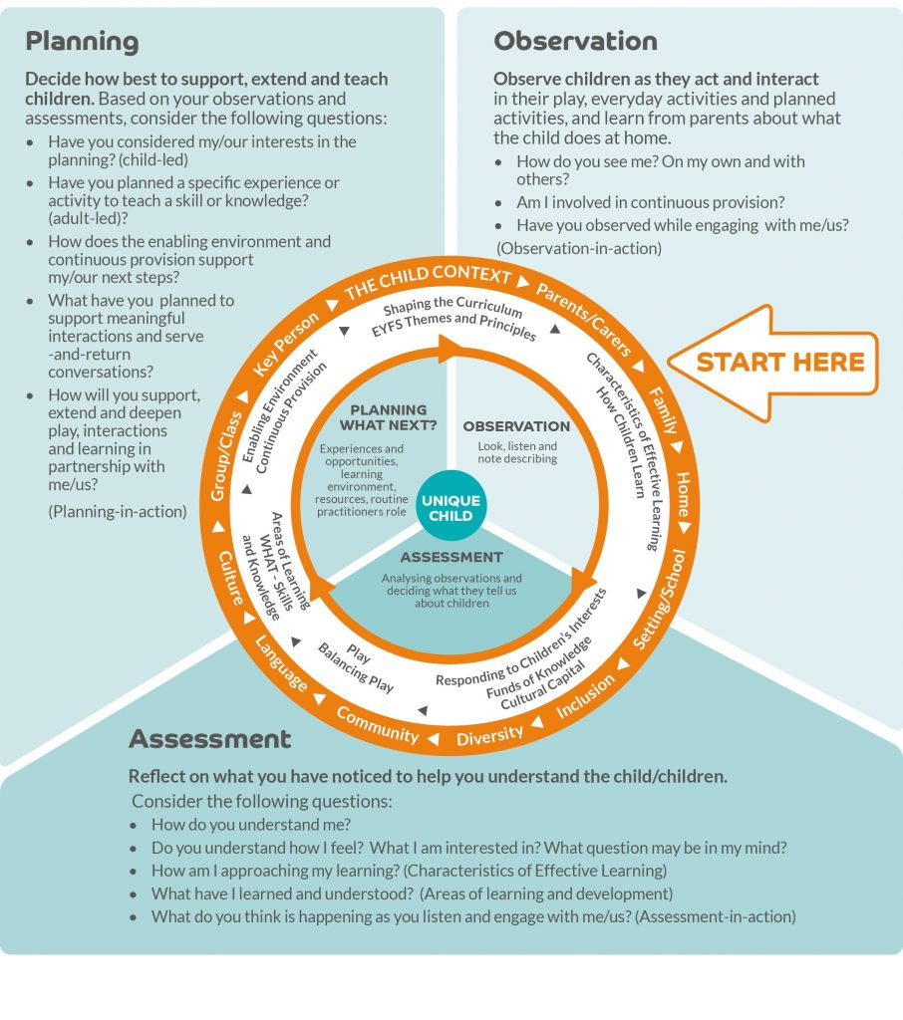
Observation, Planning and Assessment
Through noticing what children do and discussion with children and staff, areas of need and next steps are identified for all children to ensure good progress is made. There are also a range of stimulating and engaging activities which the children can access independently and a variety of opportunities for child-initiated play. In planning and guiding children’s activities we reflect on the different ways that children learn and reflect these in our practise.
We use the ‘Development Matters’ and ‘Birth to Five’ to ensure our planning, adult interaction and learning environment; including continuous provision, support children to reach their next steps. We will include interventions for groups or individuals if and when necessary.
Children in EYFS learn by playing and exploring, being active, and through creative and critical thinking which takes place both indoors and outside. Our outdoor areas are used all year round and in most weather conditions. We ensure activities support the Characteristics of Effective Learning to ensure learning takes place. These are:
Playing and Exploring – children investigate and experience things, and have a go;
Active Learning – children concentrate and keep on trying if they encounter difficulties, and enjoy achievements;
Creating and Thinking Critically – children have and develop their own ideas, make links between ideas and develop strategies for doing things.
Transition into Year 1
Our curriculum is designed with the children in mind to enable the children to leave the Foundation Stage as well rounded individuals and to be ready for the next step in their learning in Year 1.
To support the transitional process to Year 1. The children have many opportunities to visits to their new learning environment and meeting their new teacher. We feel it is important to ensure the environments in Year 1 are similar to that of the EYFS especially in the Autumn term.

Slide 4
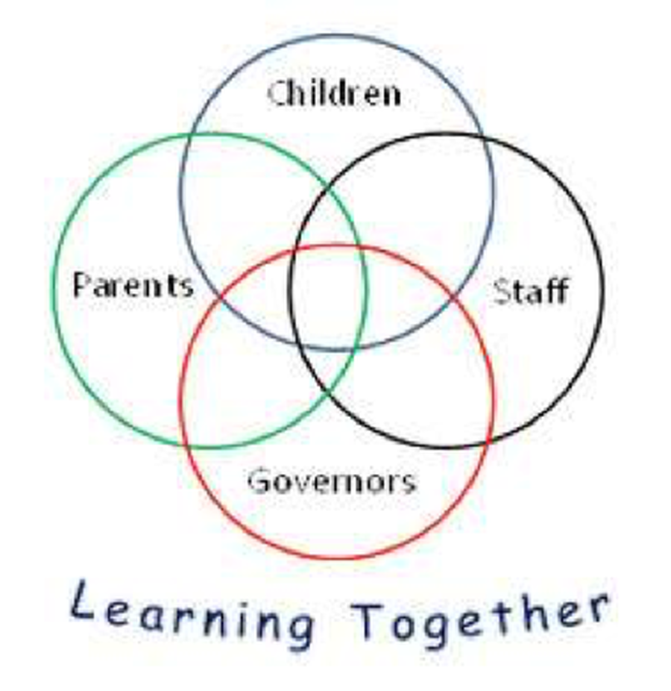
Our Aims and Values | St Andrew’s School
Core Principles | Our aim is to provide a living, Christian school environment, where the full potential of each child is realised through personal, social, academic and spiritual development. ‘Learning together what is good and right’ Job 34:4 At St Andrew’s we are committed to developing the skills and appetite for lifelong learning. We recognise that each of our key stakeholders will contribute and benefit from participating in this ambition. Through open communication we create positive learning relationships We teach reflection so we can positively learn from our experiences We gather and organise information so we can ‘meaning make’ We identify tasks and generate ideas so we can grow our critical curiosity We encourage creativity and a can-do attitude We develop strategic awareness to build resilience in our thinking
The symptom of an educated person is good character, which includes empathy, gratitude, courage, integrity, self-discipline and respect.

Slide 5






Foundation Long Term Plan 24-25
 | Autumn 1 | Autumn 2 | Spring 1 | Spring 2 | Summer 1 | Summer 2
General Themes NB: These themes may be adapted at various points to allow for children’s interests to flow through the provision WELL-BEING & Behaviour For Learning | All About me! Starting school / my new class People who help us / Careers Staying healthy / Food / Human body How have I changed? My family / PSED focus What am I good at? How do I make others feel? Being kind / staying safe Dental care | Terrific Tales! Traditional Tales Little Red Hen - Harvest The three Billy goats gruff Library visits Gingerbread Man Cinderella The Nativity Christmas Lists Letters to Father Christmas | Amazing Animals! Life cycles Animals around the world Climates / Hibernation Down on the Farm Mini Beasts Animal Arts and crafts Night and day animals Animal patterns David Attenborough Happy Habitats Forest school week | Come Outside! Plants & Flowers Weather / seasons Does the moon shine? The great outdoors Planting seeds Make a sculpture: Andy Goldsworthy Reduce, Reuse & Recycle Fun Science / Materials | Ticket to ride! Around the village How do I get there? Where in the world have you been? Where do we live in the UK / world? Fly me to the moon! Design your own transport! Who was Neil Armstrong? | Under the Sea! Under the sea Patterns Marine life Fish poetry Sea shanties Habitats Pollution and conservation Ahoy there! – Pirates Floating and sinking Boat designing
Possible Texts and ‘old favourites’ | Meesha makes friends The growing story Owl Babies Once there were Giants Stick Man The Smartest Giant The Colour Monster The Rainbow Fish Funny Bones The Big Book of Families | The Jolly Postman Goldilocks Farmer Duck Hansel & Gretal The Ugly Duckling Christmas Story / Nativity Rama and Sita | The Emperors Egg What the ladybird heard The Very Hungry Caterpillar Aghh Spider! Tiger who came to tea Diary of a wombat Elephant and the Bad Baby Pig in the Pond | The Tiny Seed Oliver’s Vegetables Jack and the Beanstalk One Plastic Bag Jasper’s Beanstalk Tree, Seasons come and seasons go A stroll through the seasons | The Snail and the Whale The Way back Home Mr. Gumpy’s Outing The Train Ride Bob, The Man on the Moon Beegu Oi! Get off my train! | Under the Sea Non – Fiction Tiddler Flotsom Sharing a shell The wide sea What a waste Somebody swallowed Stanley
‘Wow’ moments / Enrichment Weeks | Autumn Trail Remembrance Day Nurse / Firefighter visit Harvest Time Birthdays Favourite Songs Talent show What do I want to be when I grow up? picture for display. | Christmas Time / Nativity Diwali Black History Month Remembrance day Road Safety Stories by the Fireside Children in Need Anti- Bullying Week Theatre trip | Chinese New Year LENT Valentine’s Day Post a letter Burrator Forest school trip Grow caterpillars Tadpoles | Walk to the park / Picnic Planting seeds Easter time Weather experiments Weather Forecast videos Nature Scavenger Hunt Vincent Van Gogh Study Mother’s Day Science Week Easter Egg Hunt | Art Gallery Food tasting – different cultures Map work - Find the Treasure Let’s fly - Role play and Green Screen | Under the Sea – singing songs and sea shanties Aquarium trip Father’s Day Heathy Eating Week Pirate Day Picnic at the park

Slide 6

Foundation Long Term Plan 24-25
 | Autumn 1 | Autumn 2 | Spring 1 | Spring 2 | Summer 1 | Summer 2
General Themes | All About me! | Terrific Tales! | Ticket to ride! | Come Outside! | amazing! | Under the sea!
Over Arching Principles | Characteristics of Effective Learning Playing and exploring: - Children investigate and experience things, and ‘have a go’. Children who actively participate in their own play develop a larger store of information and experiences to draw on which positively supports their learning Active learning: - Children concentrate and keep on trying if they encounter difficulties. They are proud of their own achievements. For children to develop into self-regulating, lifelong learners they are required to take ownership, accept challenges and learn persistence. Creating and thinking critically: - Children develop their own ideas and make links between these ideas. They think flexibly and rationally, drawing on previous experiences which help them to solve problems and reach conclusions.
Over Arching Principles | Unique Child: Every child is unique and has the potential to be resilient, capable, confident and self-assured. Positive Relationships: Children flourish with warm, strong & positive partnerships between all staff and parents/carers. This promotes independence across the EYFS curriculum. Children and practitioners are NOT alone – embrace each community. Enabling environments: Children learn and develop well in safe and secure environments where routines are established and where adults respond to their individual needs and passions and help them to build upon their learning over time. Learning and Development: Children develop and learn at different rates (not in different ways as it stated 2017). We must be aware of children who need greater support than others. PLAY: At St Andrew’s, we understand that children learn best when they are absorbed, interested and active. We understand that active learning involves other children, adults, objects, ideas, stimuli and events that aim to engage and involve children for sustained periods. We believe that Early Years education should be as practical as possible and therefore , we are proud that our EYFS setting has an underlying ethos of ‘Learning through play. PLAY is essential for children’s development across all areas. Play builds on children’s confidence as they learn to explore, to relate to others around them and develop relationships , set their own goals and solve problems. Children learn by leading their own play and by taking part in play which is guided by adults.’. EYFS Team We will ensure that all children learn and develop well and are kept healthy and safe at ALL times.
COEL
The ultimate purpose of education, for adults and children, is to help them cultivate love, which is both an aesthetic and rational experience.

Slide 7
Foundation Long Term Plan 24-25
 | Autumn 1 | Autumn 2 | Spring 1 | Spring 2 | Summer 1 | Summer 2
General Themes | All About me! | Terrific Tales! | Ticket to RIDE! | Come Outside! | Amazing animals! | Fun at the seaside!
British Values Assemblies / Sharing Circles These will mirror the principles and values of our school We will ‘dip in and out of each area’ each term as and when we need to. | Mutual respect We are all unique. We respect differences between different people and their beliefs in our community, in this country and all around the world. All cultures are learned , respected, and celebrated. | Mutual Tolerance Everyone is valued, all cultures are celebrated and we all share and respect the opinions of others. Mutual tolerance of those with different faiths and beliefs and for those without faith. | Rule of law We all know that we have rules at school that we must follow. We know who to talk to if we do not feel safe. We know right from wrong. We recognise that we are accountable for our actions. We must work together as a team when it is necessary. | Individual liberty We all have the right to have our own views. We are all respected as individuals. We feel safe to have a go at new activities. We understand and celebrate the fact that everyone is different. | Democracy We all have the right to be listened to. We respect everyone and we value their different ideas and opinions. We have the opportunity to play with who we want to play with. We listen with intrigue and value and respect the opinions of others. | Recap all British Values Fundamental British Values underpin what it is to be a citizen in a modern and diverse Great Britain valuing our community and celebrating diversity of the UK. Fundamental British Values are not exclusive to being British and are shared by other democratic countries.
Assessment opportunities | Analyse Nursery Assessments In-house - Baseline data on entry National Baseline data by end of term Phonic Intervention groups | On going assessments Baseline analysis Pupil progress meetings Parents evening info EYFS team meetings In house moderation End/Mid term Assessments | GLD Projections for EOY Partnership moderation EYFS team meetings Phase meeting and internal moderations | Pupil progress meetings Parents evening info EYFS team meetings | Local schools moderation EYFS team meetings | Pupil progress meetings Parents evening info EYFS team meetings EOY data
Parental Involvement | Staggered Start Home visits / Parents Evening Harvest Assembly WOW Tree Phonics workshop Maths Workshop Tapestry | WOW tree Nativity Writing workshop Parents Evening Book at Bedtime Tapestry | WOW tree Share a story Stay and Read morning Tapestry | WOW Tree Parents Evening Art Gallery Share a story Tapestry | WOW Tree Share a story Look how far we have come! | WOW Tree Share a story Parent report feedback Parent’s Picnic
We recognise that all children are unique and special.

Slide 8
Foundation Long Term Plan 24-25
 | Autumn 1 | Autumn 2 | Spring 1 | Spring 2 | Summer 1 | Summer 2
General Themes | All About me! | Terrific Tales! | Amazing animals! | Come Outside! | Ticket to ride! | Under the sea!
Jigsaw Class charter and following the school behaviour policy including rewards and sacntions. Weekly celebrations linked to puzzle pieces. | Being me in my world 6 pieces, including class assembly and 2 mindfulness sessions to introduce the children to calm me time, paws points and Jerrie the cat. *I understand how it feels to belong and that we are similar and different. Jigsaw Jenie, favourite toys/why. Opp to play with the toys after session. Sticky labels for home – favourite toys. *I can start to recognise and manage my feelings. Look at/ discuss different emotions. Explore expressions. Photos of best smiles. *I enjoy working with others to make school a good place to be. Role play, discuss problems and solutions. *I understand why it is good to be kind and use gentle hands. Hands are not for hitting. Kind hand eg’s. *I am starting to understand children’s rights and this means we should all be allowed to learn and play. Rights and school rules. Making own healthy snacks. *I am learning what being responsible means. Being in charge of toys, resources in the classroom. | Celebrating difference *I can identify something I am good at and understand everyone is good at different things. Explore what we are good at home/school. *I understand that being different makes us all special. I’m special paperchain. Naked Trevor book. *I know we are all different but the same in some ways. Role play families, images of diff families. The family book – Make our own. *I can tell you why I think my home is special to me. Our homes – how are they unique? Build diff houses for teddies etc. *I can tell you how to be a kind friend. Explore friendships, what to do if your friend is away. Friends at school and outside of school. What makes a good friend. *I know which words to use to stand up for myself when someone says or does something unkind. Role play different situations, promote use of language such as please don’t do that I don’t like it. | Dreams and Goals *I understand that if I persevere I can tackle challenges. Different challenges to tackle – PE, motor, home/school. *I can tell you about a time I didn’t give up until I achieved my goal. Challenges that be overcome. Wow moments. *I can set a goal and work towards it. Create goals and plan activities to support reaching them. *I can use kind words to encourage people. Saying good things to our friends and helping them with our skills. *I understand the link between what I learn now and the job I might like to do when I’m older. Rocket role play, show/tell jobs, job role play. *I can say how I feel when I achieve a goal and know what it means to feel proud. Proud footprints for what they have achieved this term. | Healthy Me *I understand that I need to exercise to keep my body healthy. Activity colourings to cut out. Timed sports exercises. *I understand how moving and resting are good for my body. Active play, team games. *I know which foods are healthy and not so healthy and can make healthy eating choices. Role play food area. Make fruit kebabs. Discuss favourite foods. Link with home – promote healthy choices. *I know how to help myself go to sleep and understand why sleep is good for me. Teddies, cushions and blankets to role ply bedtime. Draw label bed time routine. *I can wash my hands thoroughly and understand why this is important especially before I eat and after I go to the toilet. Dolls to wash. Make posters for handwashing. *I know what a stranger is and how to stay safe if a stranger approaches me. Stranger danger, safer strangers. Role play, discuss different situations the children could find themselves in and what they can do/say. | Relationships *I can identify some of the jobs I do in my family and how I feel like I belong. Share our family photos, role play house – different cultures. *I know how to make friends to stop myself from feeling lonely. Teamwork games inside and outside. *I can think of ways to solve problems and stay friends. Role play situations, praise good examples, social stories. *I am starting to understand the impact of unkind words. Display of kind word. *I can use Calm Me time to manage my feelings. Drawing to music, puppets for role play, calm me times. *I know how to be a good friend. Take photos of our friends, promote good friends, kind friends, who are our friends and why do we like them? | Changing Me *I can name parts of the body. Draw a body shape and label it. Non-fiction books to explore. *I can tell you some things I can do and foods I can eat to be healthy. Make healthy food plates from magazine images. Role play picnics, team games. *I understand that we all grow from babies to adults. Plant seeds and watch them grow. How have they grown? What can they do now that they couldn’t as babies? *I can express how I feel about moving to Year 1. Opportunities to mix with year 1 and play with year 1 resources. Worry box/opportunities to share concerns. *I can talk about my worries and/or the things I am looking forward to about being in Year 1. Jigsaw Jack to visit. Year teacher to visit/story time. Letters/cards from year 1. Photos of year 1 activities. *I can share my memories of the best bits of this year in Reception. Create a memories box, look back at photos, share thoughts/reflections from the last year. Celebrate and be proud!
Core Principles
The symptom of an educated person is good character, which includes empathy, gratitude, courage, integrity, self-discipline and respect.

Slide 9
Foundation Long Term Plan 24-25
 | Autumn 1 | Autumn 2 | Spring 1 | Spring 2 | Summer 1 | Summer 2
General Themes | All About me! | Terrific Tales! | Amazing animals! | Come Outside! | Ticket to ride! | Under the sea!
Religious Education Children will encounter Christianity and other faiths, as part of their growing sense of self, their own community and their place within it | Why is the word ‘God’ so important to Christians? (God) | Whys is Christmas so special to Christians? (Incarnation) Act out stories about Jesus as an adult. Connect the baby Jesus with the adult Jesus –Jesus is not just a baby, but God. Listen to and understand that the nativity story come from the Bible. Christians celebrate Christmas as the birth of Christ. Christmas events at churches are numerous. | Being special where do we belong? Retell religious stories, making connections with personal experiences. Share and record occasions when things have happened in their lives that made them feel special. Recall simply what happens at a traditional Christian infant baptism and dedication. Recall simply what happens when a baby is welcomed into a religion other than Christianity. | Why is Easter special to Christians? (Salvation) Recall the story of Palm Sunday Learn that palm leaves or palm crosses are often distributed to worshippers. Talk about that for Christians, Easter is the most important festival of the year Learn Talk about that Easter is a mixture of sorrow, reflection, joy and hope. Easter is a big celebration in Britain, dominated by chocolate eggs, with a focus on springtime. Talk about Christian belief that Jesus rose victorious from death to new life, and that he gives his followers hope of forgiveness. Identify signs of new life. | Which places are special and why? Talk about somewhere that is special to themselves, saying why. Recognise that some religious people have places which have special meaning for them. Talk about the things that are special are special and valued in a place of worship. Identify some significant features of sacred places. Recognise a place of worship. Get to know and use appropriate words to talk about their thoughts and feelings when visiting a church. Express a personal response to the natural world, | Which stories are special and why? Talk about some religious stories. Recognise some religious words, e.g. about God. Identify some of their own feelings in the stories they hear. Identify a sacred text e.g. Bible, Qur’an. Talk about what Jesus teaches about keeping promises is a good thing to do. Talk about what Jesus teaches about saying ‘thank you’, and why it is good to thank and be thanked.
The symptom of an educated person is good character, which includes empathy, gratitude, courage, integrity, self-discipline and respect.

Slide 10

Foundation Long Term Plan 24-25
 | Autumn 1 | Autumn 2 |  | Spring 1 |  | Spring 2 |  | Summer 1 |  | Summer 2
General Themes | All About me! | Terrific Tales! |  | Amazing animals ! |  | Come Outside! |  | Ticket to ride! |  | Under the sea!
Communication and Language | The development of children’s spoken language underpins all seven areas of learning and development. Children’s back-and-forth interactions from an early age form the foundations for language and cognitive development. The number and quality of the conversations they have with adults and peers throughout the day in a language-rich environment is crucial. By commenting on what children are interested in or doing, and echoing back what they say with new vocabulary added, practitioners will build children's language effectively. Reading frequently to children, and engaging them actively in stories, non-fiction, rhymes and poems, and then providing them with extensive opportunities to use and embed new words in a range of contexts, will give children the opportunity to thrive. Through conversation, story-telling and role play, where children share their ideas with support and modelling from their teacher, and sensitive questioning that invites them to elaborate, children become comfortable using a rich range of vocabulary and language structures.
Whole EYFS Focus – C&L is developed throughout the year through high quality interactions, daily group discussions, sharing circles, Jigsaw sessions, stories, singing, speech and language interventions, NELI , story telling sessions actions, EYFS productions, assemblies and weekly interventions. Daily story time | Welcome to EYFS Settling in activities Making friends Children talking about experiences that are familiar to them What are your passions / goals / dreams? This is me! Rhyming and alliteration Familiar Print Sharing facts about me! Mood Monsters Shared stories All about me! Model talk routines through the day. For example, arriving in school: “Good morning, how are you?” |  | Tell me a story! Develop vocabulary Discovering Passions Tell me a story - retelling stories Story language Word hunts Listening and responding to stories Following instructions Takes part in discussion Understand how to listen carefully and why listening is important. Use new vocabulary through the day. Choose books that will develop their vocabulary. |  | Tell me why! Using language well Ask’s how and why questions… Discovering Passions Retell a story with story language Ask questions to find out more and to check they understand what has been said to them. Describe events in some detail. Listen to and talk about stories to build familiarity and understanding. Learn rhymes, poems and songs. |  | Talk it through! Describe events in detail – time connectives Discovering Passions Understand how to listen carefully and why listening is important. Use picture cue cards to talk about an object: “What colour is it? Where would you find it? Sustained focus when listening to a story |  | What happened? Discovering Passions Re-read some books so children learn the language necessary to talk about what is happening in each illustration and relate it to their own lives |  | Time to share! Show and tell Weekend news Discovering Passions Read aloud books to children that will extend their knowledge of the world and illustrate a current topic. Select books containing photographs and pictures, for example, places in different weather conditions and seasons.
We understand that children will make progress at different times. There is no right time… they will progress when they are ready.

Slide 11


Foundation Long Term Plan 24-25
 | Autumn 1 | Autumn 2 |  | Spring 1 |  | Spring 2 |  | Summer 1 |  | Summer 2
General Themes | All About me! | Terrific Tales! |  | Amazing animals! |  | Come Outside! |  | Ticket to ride! |  | Under the sea!
Personal, Social and Emotional Development | Children’s personal, social and emotional development (PSED) is crucial for children to lead healthy and happy lives, and is fundamental to their cognitive development. Underpinning their personal development are the important attachments that shape their social world. Strong, warm and supportive relationships with adults enable children to learn how to understand their own feelings and those of others. Children should be supported to manage emotions, develop a positive sense of self, set themselves simple goals, have confidence in their own abilities, to persist and wait for what they want and direct attention as necessary. Through adult modelling and guidance, they will learn how to look after their bodies, including healthy eating, and manage personal needs independently. Through supported interaction with other children, they learn how to make good friendships, co-operate and resolve conflicts peaceably. These attributes will provide a secure platform from which children can achieve at school and in later life.
Managing Self Self - Regulation | New Beginnings See themselves as a valuable individual. Being me in my world Class Rule Rules and Routines Supporting children to build relationships Dreams and Goals |  | Getting on and falling out. How to deal with anger Emotions Self - Confidence Build constructive and respectful relationships. Ask children to explain to others how they thought about a problem or an emotion and how they dealt with it. |  | Good to be me Feelings Learning about qualities and differences Celebrating differences Identify and moderate their own feelings socially and emotionally. Encourage them to think about their own feelings and those of others by giving explicit examples of how others might feel in particular scenarios |  | Relationships What makes a good friend? Healthy me Random acts of Kindness Looking after pets Looking After our Planet Give children strategies for staying calm in the face of frustration. Talk them through why we take turns, wait politely, tidy up after ourselves and so on | Looking after others | Looking after others Friendships Dreams and Goals Show resilience and perseverance in the face of challenge. Discuss why we take turns, wait politely, tidy up after ourselves and so on. | Taking part in sports day - Winning and loosing Changing me Look how far I've come! Model positive behaviour and highlight exemplary behaviour of children in class, narrating what was kind and considerate about the behaviour.
Self - Regulation Link to Behaviour for Learning | Show an understanding of their own feelings and those of others, and begin to regulate their behaviour accordingly. Set and work towards simple goals, being able to wait for what they want and control their immediate impulses when appropriate. Give focused attention to what the teacher says, responding appropriately even when engaged in activity, and show an ability to follow instructions involving several ideas or actions. Controlling own feelings and behaviours Applying personalised strategies to return to a state of calm Being able to curb impulsive behaviours Being able to concentrate on a task Being able to ignore distractions Behaving in ways that are pro-social Planning Thinking before acting Delaying gratification Persisting in the face of difficulty. |  |  |  |  |  | “Self-regulatory skills can be defined as the ability of children to manage their own behaviour and aspects of their learning. In the early years, efforts to develop self-regulation often seek to improve levels of self-control and reduce impulsivity. Activities typically include supporting children in articulating their plans and learning strategies and reviewing what they have done.” Education Endowment Foundation.
We understand that children develop in individual ways and at varying rates – physically, cognitively, linguistically, socially and emotionally.

Slide 12

Foundation Long Term Plan 24-25
 | Autumn 1 | Autumn 2 | Spring 1 | Spring 2 | Summer 1 | Summer 2
General Themes | All About me! | Terrific Tales! | Amazing animals! | Come Outside! | Ticket to ride! | Under the sea!
Physical development Fine motor Continuously check the process of children’s handwriting (pencil grip and letter formation, including directionality). Provide extra help and guidance when needed. Daily opportunities for Fine Motor Activities Gross motor | Physical activity is vital in children’s all-round development, enabling them to pursue happy, healthy and active lives. Gross and fine motor experiences develop incrementally throughout early childhood, starting with sensory explorations and the development of a child’s strength, co-ordination and positional awareness through tummy time, crawling and play movement with both objects and adults. By creating games and providing opportunities for play both indoors and outdoors, adults can support children to develop their core strength, stability, balance, spatial awareness, co-ordination and agility. Gross motor skills provide the foundation for developing healthy bodies and social and emotional well-being. Fine motor control and precision helps with hand-eye co-ordination, which is later linked to early literacy. Repeated and varied opportunities to explore and play with small world activities, puzzles, arts and crafts and the practice of using small tools, with feedback and support from adults, allow children to develop proficiency, control and confidence.
Fine motor | Threading, cutting, weaving, playdough, Fine Motor activities. Manipulate objects with good fine motor skills Draw lines and circles using gross motor movements Hold pencil/paint brush beyond whole hand grasp Pencil Grip | Threading, cutting, weaving, playdough, Fine Motor activities. Develop muscle tone to put pencil pressure on paper Use tools to effect changes to materials Show preference for dominant hand Engage children in structured activities: guide them in what to draw, write or copy. Teach and model correct letter formation. | Threading, cutting, weaving, playdough, Fine Motor activities. Begin to form letters correctly Handle tools, objects, construction and malleable materials with increasing control Encourage children to draw freely. Holding Small Items / Button Clothing / Cutting with Scissors | Threading, cutting, weaving, playdough, Fine Motor activities. Hold pencil effectively with comfortable grip Forms recognisable letters most correctly formed | Threading, cutting, weaving, playdough, Fine Motor activities. Develop pencil grip and letter formation continually Use one hand consistently for fine motor tasks Cut along a straight line with scissors / Start to cut along a curved line, like a circle / Draw a cross | Threading, cutting, weaving, playdough, Fine Motor activities. Form letters correctly Copy a square Begin to draw diagonal lines, like in a triangle / Start to colour inside the lines of a picture Start to draw pictures that are recognisable / Build things with smaller linking blocks, such as Duplo or Lego
Gross motor | Cooperation games i.e. parachute games. Climbing – outdoor equipment Different ways of moving to be explored with children Changing for PE / Help individual children to develop good personal hygiene. Acknowledge and praise their efforts. Provide regular reminders about thorough handwashing and toileting. | Ball skills- throwing and catching. Crates play- climbing. Skipping ropes in outside area dance related activities Provide a range of wheeled resources for children to balance, sit or ride on, or pull and push. Two-wheeled balance bikes and pedal bikes without stabilisers, skateboards, wheelbarrows, prams and carts are all good options | Ball skills- aiming, dribbling, pushing, throwing & catching, patting, or kicking Ensure that spaces are accessible to children with varying confidence levels, skills and needs. Provide a wide range of activities to support a broad range of abilities. Dance / moving to music Gymnastics ./ Balance | Balance- children moving with confidence dance related activities Provide opportunities for children to, spin, rock, tilt, fall, slide and bounce. Use picture books and other resources to explain the importance of the different aspects of a healthy lifestyle. | Obstacle activities children moving over, under, through and around equipment Encourage children to be highly active and get out of breath several times every day. Provide opportunities for children to, spin, rock, tilt, fall, slide and bounce. Dance / moving to music | Races / team games involving gross motor movements dance related activities Allow less competent and confident children to spend time initially observing and listening, without feeling pressured to join in. Gymnastics ./ Balance
 | From Development Matters 20’: Revise and refine the fundamental movement skills they have already acquired: - rolling - crawling - walking - jumping - running - hopping - skipping – climbing Progress towards a more fluent style of moving, with developing control and grace. Develop the overall body strength, co-ordination, balance and agility needed to engage successfully with future physical education sessions and other physical disciplines including dance, gymnastics, sport and swimming. Develop their small motor skills so that they can use a range of tools competently, safely and confidently. Suggested tools: pencils for drawing and writing, paintbrushes, scissors, knives, forks and spoons. Use their core muscle strength to achieve a good posture when sitting at a table or sitting on the floor. Confidently and safely use a range of large and small apparatus indoors and outside, alone and in a group. Develop overall body-strength, balance, co-ordination and agility. Further develop and refine a range of ball skills including: throwing, catching, kicking, passing, batting, and aiming. Develop confidence, competence, precision and accuracy when engaging in activities that involve a ball.
All these ideas will be revisited each term. Children need time to practice and consolidate. Repetition is a good thing.

Slide 13

Foundation Long Term Plan 24-25
 | Autumn 1 | Autumn 2 | Spring 1 | Spring 2 | Summer 1 | Summer 2
General Themes | All About me! | Terrific Tales! | Amazing animals! | Come Outside! | Ticket to ride! | Under the sea!
Literacy Comprehension - Developing a passion for reading Children will visit the library weekly Word Reading Children will be working in different groups for Read Write Inc. – Focus on consolidation of set 1 sounds and Set 2 Sounds, Green words . Ditty sheets, introduction of Red Ditty Books and Purple books for more confident readers. | It is crucial for children to develop a life-long love of reading. Reading consists of two dimensions: language comprehension and word reading. Language comprehension (necessary for both reading and writing) starts from birth. It only develops when adults talk with children about the world around them and the books (stories and non-fiction) they read with them, and enjoy rhymes, poems and songs together. Skilled word reading, taught later, involves both the speedy working out of the pronunciation of unfamiliar printed words (decoding) and the speedy recognition of familiar printed words. Writing involves transcription (spelling and handwriting) and composition (articulating ideas and structuring them in speech, before writing)
Literacy Comprehension | Joining in with rhymes and showing an interest in stories with repeated refrains. Environment print. Having a favourite story/rhyme. Understand the five key concepts about print: - print has meaning - print can have different purposes - we read English text from left to right and from top to bottom - the names of the different parts of a book Sequencing familiar stories through the use of pictures to tell the story. Recognising initial sounds. Name writing activities. Engage in extended conversations about stories, learning new vocabulary. | Retell stories related to events through acting/role play. Christmas letters/lists. Retelling stories using images / apps. Pie Corbett Actions to retell the story – Story Maps. Retelling of stories. Editing of story maps and orally retelling new stories. Non-Fiction Focus Retelling of stories. Sequence story – use vocabulary of beginning, middle and end. Blend sounds into words, so that they can read short words made up of known letter– sound correspondences. Enjoys an increasing range of books | Making up stories with themselves as the main character – Using Tales Toolkit strategy. Encourage children to record stories through picture drawing/mark making for LAs. Read simple phrases and sentences made up of words with known letter–sound correspondences and, where necessary, a few exception words. Read a few common exception words matched to RWI. Make the books available for children to share at school and at home. Avoid asking children to read books at home they cannot yet read | Information leaflets about animals in the garden/plants and growing. Re-read books to build up their confidence in word reading, their fluency and their understanding and enjoyment. World Book Day Timeline of how plants grow. Uses vocabulary and forms of speech that are increasingly influenced by their experiences of books. They develop their own narratives and explanations by connecting ideas or events | Stories from other cultures and traditions Retell a story with actions and / or picture prompts as part of a group - Use story language when acting out a narrative. Rhyming words. Parents reading stories Can explain the main events of a story - Can draw pictures of characters/ event / setting in a story. May include labels, sentences or captions. Story bags/ baskets | Can draw pictures of characters/ event / setting in a story Listen to stories, accurately anticipating key events & respond to what they hear with relevant comments, questions and reactions. Make predictions Beginning to understand that a non-fiction is a non-story- it gives information instead. Fiction means story. - Can point to front cover, back cover, spine, blurb, illustration, illustrator, author and title. Sort books into categories.
Word Reading | Phonic Sounds: RWI Set 1 whole class Reading: Initial sounds, oral blending, CVC sounds, reciting know stories, listening to stories with attention and recall. Help children to read the sounds speedily. This will make sound-blending easier Listen to children read aloud, ensuring books are consistent with their developing phonic knowledge | Phonic Sounds: RWI Differentiated groups Reading: Blending CVC sounds, rhyming, alliteration, knows that print is read from left to right. Spotting diagraphs in words. Show children how to touch each finger as they say each sound. For exception words such as ‘the’ and ‘said’, help children identify the sound that is tricky to spell. | Phonic Sounds: RWI Differentiated groups / Ditties Reading: Rhyming strings, common theme in traditional tales, identifying characters and settings. Help children to become familiar with letter groups, such as ‘th’, ‘sh’, ‘ch’, ‘ee’ ‘or’ ‘igh’. Provide opportunities for children to read words containing familiar letter groups: ‘that’, ‘shop’, ‘chin’, ‘feet’, ‘storm’, ‘night’. | Phonic Sounds: RWI Differentiated groups Reading: Story structure-beginning, middle, end. Innovating and retelling stories to an audience, non-fiction books. Listen to children read some longer words made up of letter-sound correspondences they know: ‘rabbit’, ‘himself’, ‘jumping’. Children should not be required to use other strategies to work out words. | Phonic Sounds: RWI Differentiated groups: Reading: Non-fiction texts, Internal blending, Naming letters of the alphabet. Distinguishing capital letters and lower case letters. Note correspondences between letters and sounds that are unusual or that they have not yet been taught, such as ‘do’, ‘said’, ‘were’. | Phonic Sounds: RWI Differentiated groups Reading: Reading simple sentences with fluency. Reading CVCC and CCVC words confidently. End of term assessments Transition work with Year 1 staff
We will provide experiences which build on children’s existing knowledge and understanding in order to challenge, stimulate and extend their learning and development

Slide 14
Foundation Long Term Plan 24-25
 | Autumn 1 | Autumn 2 | Spring 1 | Spring 2 | Summer 1 | Summer 2
General Themes | All About me! | Terrific Tales! | Amazing animals! | Come Outside! | Ticket to ride! | Under the sea!
Writing Texts may change due to children’s interests Only ask children to write sentences when they have sufficient knowledge of letter-sound correspondences. | Texts as a Stimulus: Nursery Rhymes Label characters Giraffes cant Dance (Wishing tale) – Create an I wish picture / make marks Dominant hand, tripod grip, mark making, giving meaning to marks and labelling. Shopping lists, Writing initial sounds and simple captions. Use initial sounds to label characters / images. Silly soup. Names Labels. Captions Lists Diagrams Messages – Create a Message centre! | Texts as a Stimulus: The Little Red Hen (Journey story) Sequence the story Speech bubbles The Three Billy Goats Gruff– (Problem/ resolution tale) Wanted poster to catch the troll Name writing, labelling using initial sounds, story scribing. Retelling stories in writing area, instructions for porridge. Help children identify the sound that is tricky to spell. Sequence the story Write a sentence | Texts as a Stimulus: Hungry Caterpillar - (Cumulative) Describe foods / adjectives The Sleepy Bumblebee (Cumulative) Labels and simple captions Mini beasts – Animal Fact File – Compare two animals Writing some of the tricky words such as I, me, my, like, to, the. Writing CVC words, Labels using CVC, CVCC, CCVC words. Guided writing based around developing short sentences in a meaningful context. Create a story board. | Texts as a Stimulus: Jack and the Bean stalk – retell parts of the story / repeated refrains / speech bubbles The Tiny Seed – instructions and weekly record Healthy Food – My Menu / Bean Diary Creating own story maps, writing captions and labels, writing simple sentences. Writing short sentences to accompany story maps. Order the Easter story. Labels and captions – life cycles Recount – A trip to the park Character descriptions. Write 2 sentences | Texts as a Stimulus: Mr Gumpy’s Outing (Cumulative) Report about the animals falling into the water Man on the moon (Journey story) Retell the story in own words /Write post cards from the moon Writing recipes, lists. Writing for a purpose in role play using phonetically plausible attempts at words, beginning to use finger spaces. Form lower-case and capital letters correctly. Rhyming words. Acrostic poems | Texts as a Stimulus: Big Blue Whale (Information Text) Write facts about whales Flotsam – create own animal- write what they eat, where they live what they look like. Tiddler –rewrite own version. Story writing, writing sentences using a range of tricky words that are spelt correctly. Beginning to use full stops, capital letters and finger spaces. Innovation of familiar texts Using familiar texts as a model for writing own stories. Character description – Rainbow Fish . Write three sentences – B, M & E.
We will encourage children’s independence and decision-making, supporting them to learn through their mistakes.

Slide 15

Foundation Long Term Plan 24-25
 | Autumn 1 | Autumn 2 | Spring 1 | Spring 2 | Summer 1 | Summer 2
General Themes | All About me! | Terrific Tales! | Amazing animals! | Come outside! | Ticket to ride! | Under the sea!
Maths “Without mathematics, there’s nothing you can do. Everything around you is mathematics. Everything around you is numbers.” – Shakuntala Devi White Rose Maths | Developing a strong grounding in number is essential so that all children develop the necessary building blocks to excel mathematically. Children should be able to count confidently, develop a deep understanding of the numbers to 10, the relationships between them and the patterns within those numbers. By providing frequent and varied opportunities to build and apply this understanding - such as using manipulatives, including small pebbles and tens frames for organising counting - children will develop a secure base of knowledge and vocabulary from which mastery of mathematics is built. In addition, it is important that the curriculum includes rich opportunities for children to develop their spatial reasoning skills across all areas of mathematics including shape, space and measures. It is important that children develop positive attitudes and interests in mathematics, look for patterns and relationships, spot connections, ‘have a go’, talk to adults and peers about what they notice and not be afraid to make mistakes.
Maths | Teacher assessments Early number Early calculation Mathematical language Early understanding of pattern. Match and Sort – objects into colour, size or shape. Same and difference. Compare amounts and order them. Greater and fewer. Compare size, mass and capacity – language big and little, large and small, tall, long and short Repeating patterns | Representations of numbers to 5 Nursery rhymes Subitising, match number names to numerals and quantities. Count by touching and mark make to represent numbers 1,2 and 3. Compare 1,2 and 3. one more, count back is one less. Explore and notice different compositions of 2 and 3, Circles and triangles then 4 sided shapes. Combing shapes to build squares or bigger squares Positional language Count on and back to 4 One more and one less Night and day, tomorrow, before - order events | Comparing quantities to 5 Composition of 4 and 5 Subitising Part part whole Comparing mass, language heavy, heavier, heaviest, light, lighter, lightest Capacity – explore water, sand, rice. Counting principles. Representing numbers to 8 See how numbers are made from smaller numbers. Making pairs – odd and even Combining two groups Measure length and height and make comparisons Time – order and sequence. Language – now, before, later, soon, after, then and next | Number 9 and 10 Counting back from 10 Composition and representing. 10 frame Compare numbers to 10 Compare 2/ 3 quantities Number bonds to 10 using objects in different contexts 3D shapes Pattern – more complex patterns | Building numbers beyond 10 Identify numbers to 20 Counting patterns beyond 10 – on and back Spatial reasoning – rotation of shapes Adding more and taking away Mathematical stories in meaningful contexts Spatial reasoning – investigate different ways a given shape can be built using smaller shapes | Depth of numbers within 20 Explore numbers and strategies •Recognise and extend patterns •Apply number, shape and measures knowledge •Count forwards and backwards Numbers beyond 20 One more one less •Estimate and count •Grouping and sharing | Doubling – building numbers using the pair- wise patterns on 10 frames Sharing and grouping Even and odd Spatial reasoning – places and models can be replicated and look at these from different positions. Map making Problem solving Patterns – relationship between numbers and shapes
Our educational method is grounded in the conviction that every individual is spiritual by nature and therefore possesses incredible capacity for learning and growth.

Slide 16

Foundation Long Term Plan 24-25
 | Autumn 1 | Autumn 2 |  | Spring 1 | Spring 2 |  | Summer 1 | Summer 2
General Themes | All About me! | Terrific Tales! |  | Amazing animals! | Come Outside! |  | Ticket to ride! | Under the sea!
Understanding the world Children will have opportunity to develop their emerging moral and cultural awareness. | Understanding the world involves guiding children to make sense of their physical world and their community. The frequency and range of children’s personal experiences increases their knowledge and sense of the world around them – from visiting parks, libraries and museums to meeting important members of society such as police officers, nurses and firefighters. In addition, listening to a broad selection of stories, non-fiction, rhymes and poems will foster their understanding of our culturally, socially, technologically and ecologically diverse world. As well as building important knowledge, this extends their familiarity with words that support understanding across domains. Enriching and widening children’s vocabulary will support later reading comprehension.
Understanding the world RE / Festivals Our RE Curriculum enables children to develop a positive sense of themselves and others and learn how to form positive and respectful relationships. They will begin to understand and value the differences of individuals and groups within their own community. Children will have opportunity to develop their emerging moral and cultural awareness. | Identifying their family. Commenting on photos of their family; naming who they can see and of what relation they are to them. Can talk about what they do with their family and places they have been with their family. Can draw similarities and make comparisons between other families. Name and describe people who are familiar to them. Read fictional stories about families and start to tell the difference between real and fiction. Talk about members of their immediate family and community. Navigating around our classroom and outdoor areas. Create treasure hunts to find places/ objects within our learning environment. Introduce children to different occupations and how they use transport to help them in their jobs. Listen out for and make note of children’s discussion between themselves regarding their experience of past birthday celebrations. Long ago – How time has changed. Using cameras. | Can talk about what they have done with their families during Christmas’ in the past. Show photos of how Christmas used to be celebrated in the past. Use world maps to show children where some stories are based. Use the Jolly Postman to draw information from a map and begin to understand why maps are so important to postmen. Share different cultures versions of famous fairy tales. To introduce children to a range of fictional characters and creatures from stories and to begin to differentiate these characters from real people in their lives. Stranger danger (based on Jack and the beanstalk). Talking about occupations and how to identify strangers that can help them when they are in need. | Can talk about what they have done with their families during Christmas’ in the past. Show photos of how Christmas used to be celebrated in the past. Use world maps to show children where some stories are based. Use the Jolly Postman to draw information from a map and begin to understand why maps are so important to postmen. Share different cultures versions of famous fairy tales. To introduce children to a range of fictional characters and creatures from stories and to begin to differentiate these characters from real people in their lives. Stranger danger (based on Jack and the beanstalk). Talking about occupations and how to identify strangers that can help them when they are in need. | .Listen to children describing and commenting on things they have seen whilst outside, including plants and animals. After close observation, draw pictures of the natural world, including animals and plants Looking at map of the world and where some animals live Can children differentiate between land and water. Explore different habitats Explore a range of minibeats Learn their names and label their body parts. Document the change in the caterpillars and tadpoles Nocturnal Animals Making sense of different environments and habitats Use images, video clips, shared texts and other resources to bring the wider world into the classroom. Listen to what children say about what they see | Trip to our local park (to link with seasons); discuss what we will see on our journey to the park and how we will get there. Introduce the children to recycling and how it can take care of our world. Look at what rubbish can do to our environment and animals. Create opportunities to discuss how we care for the natural world around us. Can children make comments on the weather, culture, clothing, housing. Change in living things – Changes in the leaves, weather, seasons, Explore the world around us and see how it changes as we enter Summer. Provide opportunities for children to note and record the weather. Building a ‘Bug Hotel’ Draw children’s attention to the immediate environment, introducing and modelling new vocabulary where appropriate. Encourage interactions with the outdoors to foster curiosity and give children freedom to touch, smell and hear the natural world around them during hands-on experiences. Look for children incorporating their understanding of the seasons and weather in their play. Use the BeeBots | Discuss how they got to school and what mode of transport they used. Introduce the children to a range of transport and where they can be found. Look at the difference between transport in this country and one other country. Encourage the children to make simple comparisons. Use bee-bots on simple maps. Encourage the children to use navigational language. Can children talk about their homes and what there is to do near their homes? Look out for children drawing/painting or constructing their homes. Encourage them to comment on what their home is like. Show photos of the children’s homes and encourage them to draw comparisons. Environments – Features of local environment Maps of local area Comparing places on Google Earth – how are they similar/different? Introduce the children to NASA and America. Introduce children to significant figures who have been to space and begin to understand that these events happened before they were born. Take children to places of worship and places of local importance to the community Listening to stories and placing events in chronological order. | Use Handa’s Surprise to explore a different country. Discuss how they got to school and what mode of transport they used. Introduce the children to a range of transport and where they can be found. Look at the difference between transport in this country and one other country. Encourage the children to make simple comparisons. Use bee-bots on simple maps. Encourage the children to use navigational language. Can children talk about their homes and what there is to do near their homes? Look out for children drawing/painting or constructing their homes. Encourage them to comment on what their home is like. Show photos of the children’s homes and encourage them to draw comparisons. Environments – Features of local environment Maps of local area Comparing places on Google Earth – how are they similar/different? Introduce the children to NASA and America. Introduce children to significant figures who have been to space and begin to understand that these events happened before they were born. Can children differentiate between land and water. | To understand where dinosaurs are now and begin to understand that they were alive a very long time ago. Learn about what a palaeontologist is and how they explore really old artefacts. Introduce Mary Anning as the first female to find a fossil. Materials: Floating / Sinking – boat building Metallic / non-metallic objects Seasides long ago – Magic Grandad | Materials: Floating / Sinking – boat building Metallic / non-metallic objects Share non-fiction texts that offer an insight into contrasting environments. How can we look after our sealife. Look at the wide sea and discuss pollution in the sea Listen to how children communicate their understanding of their own environment and contrasting environments through conversation and in play.
RE / Festivals RE is a compulsory part of the basic curriculum for all Reception age pupils, and should be taught according to this Agreed Syllabus for RE.
Developing children’s understanding of social skills and the values and codes of behaviour required for people to work together harmoniously.

Slide 17




Foundation Long Term Plan 24-25
 | Autumn 1 | Autumn 2 | Spring 1 | Spring 2 | Summer 1 | Summer 2
General Themes | All About me! | Terrific Tales! | AMAZING ANIMALS! | Come Outside! | TICKET TO RIDE! | Under the sea!
Expressive Arts and Design Painting, 3D modelling, messy play, collage, cutting, drama, role play, threading, moving to music, clay sculptures, following music patterns with instruments, singing songs linked to topics, making instruments, percussion. Children to produce a piece of art work each half for school / parents to show how drawings have developed - lots of links to Fine Motor Skills. Children to explain their work to others. Children will have opportunities to learn and perform songs, nursery rhymes and poetry linked to their work / interests and passions. | The development of children’s artistic and cultural awareness supports their imagination and creativity. It is important that children have regular opportunities to engage with the arts, enabling them to explore and play with a wide range of media and materials. The quality and variety of what children see, hear and participate in is crucial for developing their understanding, self-expression, vocabulary and ability to communicate through the arts. The frequency, repetition and depth of their experiences are fundamental to their progress in interpreting and appreciating what they hear, respond to and observe. Give children an insight into new musical worlds. Invite musicians in to play music to children and talk about it. Encourage children to listen attentively to music. Discuss changes and patterns as a piece of music develops.
Expressive Arts and Design Painting, 3D modelling, messy play, collage, cutting, drama, role play, threading, moving to music, clay sculptures, following music patterns with instruments, singing songs linked to topics, making instruments, percussion. Children to produce a piece of art work each half term to be displayed for ‘Celebration wall’ for school / parents to show how drawings have developed - lots of links to Fine Motor Skills. Children to explain their work to others. Children will have opportunities to learn and perform songs, nursery rhymes and poetry linked to their work / interests and passions. | Join in with songs; beginning to mix colours, join in with role play games and use resources available for props; build models using construction equipment. Sing call-and-response songs, so that children can echo phrases of songs you sing. Self-portraits, junk modelling, take picture of children’s creations and record them explaining what they did. Julia Donaldson songs Exploring sounds and how they can be changed, tapping out of simple rhythms. Provide opportunities to work together to develop and realise creative ideas. | Use different textures and materials to make bridges for the Three Billy Goats Listen to music and make their own dances in response. Castle models Firework pictures, Christmas decorations, Christmas cards, Divas, Christmas songs/poems The use of story maps, props, puppets & story bags will encourage children to retell, invent and adapt stories. Role Play Party’s and Celebrations Role Play of The Nativity | Kelly Stanford minibeats. symmetrical butterflies Children will be encouraged to select the tools and techniques they need to assemble materials that they are using e.g creating animal masks. Shadow Puppets Teach children different techniques for joining materials, such as how to use adhesive tape and different sorts of glue. Salt dough minibeats | Make different textures; make patterns using different colours Children will explore ways to protect the growing of plants by designing scarecrows. Collage-farm animals / Making houses. Pastel drawings, printing, patterns on Easter eggs, Life cycles, Flowers-Sun flowers Mother’s Day crafts Easter crafts Home Corner role play Artwork themed around Eric Carle / The Seasons – Art Provide a wide range of props for play which encourage imagination. | Jackson Pollock – black and white painitngs Design and make rockets. Design and make objects they may need in space, thinking about form and function. Encourage children to create their own music. Junk modelling, houses, bridges boats and transport. Exploration of other countries – dressing up in different costumes. Creating outer of space pictures Provide children with a range of materials for children to construct with . | Sand pictures / Rainbow fish collages Paper plate jellyfish Puppet shows: Provide a wide range of props for play which encourage imagination. Water pictures, collage, shading by adding black or white, colour mixing Colour mixing – underwater pictures. Father’s Day Crafts
At the heart of education is a positive, synergistic relationship between the teacher and the student. This dynamic creates the environment for learning to take place.

Slide 18






Foundation Long Term Plan 24-25
Early Learning Goals – for the end of the year - Holistic / best fit Judgement! | Early Learning Goals | Autumn 2 | Spring 1 | Spring 2 | Summer 1 | Summer 2
Communication and Language | Personal, social, emotional development | Physical Development | Literacy | Maths | Understanding the World | Expressive arts and design
ELG: Listening, Attention and Understanding Listen attentively and respond to what they hear with relevant questions, comments and actions when being read to and during whole class discussions and small group interactions Make comments about what they have heard and ask questions to clarify their understanding Hold conversation when engaged in back-and-forth exchanges with their teacher and peers ELG: Speaking Participate in small group, class and one-to-one discussions, offering their own ideas, using recently introduced vocabulary. Offer explanations for why things might happen, making use of recently introduced vocabulary from stories, non-fiction, rhymes and poems when appropriate. Express their ideas and feelings about their experiences using full sentences, including use of past, present and future tenses and making use of conjunctions, with modelling and support from their teacher. | ELG: Self-Regulation Show an understanding of their own feelings and those of others, and begin to regulate their behaviour accordingly. Set and work towards simple goals, being able to wait for what they want and control their immediate impulses when appropriate. Give focused attention to what the teacher says, responding appropriately even when engaged in activity, and show an ability to follow instructions involving several ideas or actions. ELG: Managing Self Be confident to try new activities and show independence, resilience and perseverance in the face of challenge. Explain the reasons for rules, know right from wrong and try to behave accordingly. Manage their own basic hygiene and personal needs, including dressing, going to the toilet and understanding the importance of healthy food choices. ELG: Building Relationships Work and play cooperatively and take turns with others. Form positive attachments to adults and friendships with peers;. Show sensitivity to their own and to others’ needs. | ELG: Gross Motor Skills Negotiate space and obstacles safely, with consideration for themselves and others. Demonstrate strength, balance and coordination when playing. Move energetically, such as running, jumping, dancing, hopping, skipping and climbing. ELG: Fine Motor Skills Hold a pencil effectively in preparation for fluent writing – using the tripod grip in almost all cases. Use a range of small tools, including scissors, paint brushes and cutlery. Begin to show accuracy and care when drawing. | ELG: Comprehension Demonstrate understanding of what has been read to them by retelling stories and narratives using their own words and recently introduced vocabulary. Anticipate – where appropriate – key events in stories. Use and understand recently introduced vocabulary during discussions about stories, non-fiction, rhymes and poems and during role-play. ELG: Word Reading Say a sound for each letter in the alphabet and at least 10 digraphs. Read words consistent with their phonic knowledge by sound-blending. Read aloud simple sentences and books that are consistent with their phonic knowledge, including some common exception words. ELG: Writing Write recognisable letters, most of which are correctly formed. Spell words by identifying sounds in them and representing the sounds with a letter or letters. Write simple phrases and sentences that can be read by others. | ELG: Number Have a deep understanding of number to 10, including the composition of each number; Subitise (recognise quantities without counting) up to 5; - Automatically recall (without reference to rhymes, counting or other aids) number bonds up to 5 (including subtraction facts) and some number bonds to 10, including double facts. ELG: Numerical Patterns Verbally count beyond 20, recognising the pattern of the counting system; - Compare quantities up to 10 in different contexts, recognising when one quantity is greater than, less than or the same as the other quantity. Explore and represent patterns within numbers up to 10, including evens and odds, double facts and how quantities can be distributed equally. | ELG: Past and Present Talk about the lives of the people around them and their roles in society. Know some similarities and differences between things in the past and now, drawing on their experiences and what has been read in class. Understand the past through settings, characters and events encountered in books read in class and storytelling. ELG: People, Culture and Communities Describe their immediate environment using knowledge from observation, discussion, stories, non-fiction texts and maps. Know some similarities and differences between different religious and cultural communities in this country, drawing on their experiences and what has been read in class. Explain some similarities and differences between life in this country and life in other countries, drawing on knowledge from stories, non-fiction texts and – when appropriate – maps. ELG: The Natural World Explore the natural world around them, making observations and drawing pictures of animals and plants. Know some similarities and differences between the natural world around them and contrasting environments, drawing on their experiences and what has been read in class. Understand some important processes and changes in the natural world around them, including the seasons and changing states of matter. | ELG: Creating with Materials Safely use and explore a variety of materials, tools and techniques, experimenting with colour, design, texture, form and function. Share their creations, explaining the process they have used; - Make use of props and materials when role playing characters in narratives and stories. ELG: Being Imaginative and Expressive Invent, adapt and recount narratives and stories with peers and their teacher. Sing a range of well-known nursery rhymes and songs; Perform songs, rhymes, poems and stories with others, and – when appropriate – try to move in time with music.
It is important for parents and early years settings to have a strong and respectful partnership. This sets the scene for children to thrive in the early years.

